Slide 1
BCOG 100
Pattern Recognition
Lecture 1: The Problem of Pattern Recognition

Slide 2
Reading Check 7-1
Password: pattern
Question: what is connectionism?

Slide 3
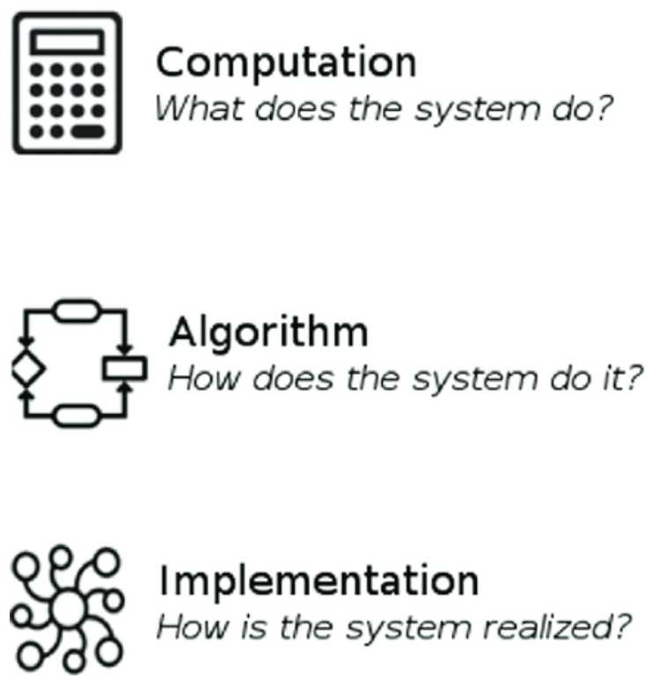
The Pattern Recognition Problem
Recap & Overview
Brains that learn
Today:
From learning to perception and action
From associations to structured recognition
Pattern recognition as the bridge between sensing and acting
Notes:
So far, we’ve seen how the evolution of the brain has gradually expanded what organisms can do with information.
First came reflexes—hardwired stimulus–response loops.
Then came Hebbian learning, which allowed those loops to be strengthened or weakened by experience.
And then reinforcement learning, which let organisms assign value to outcomes and learn sequences of actions that led to reward.
Today, we add another crucial piece: pattern recognition.
Pattern recognition is the capacity to detect regularities in sensory input
and map them onto meaningful categories or actions.
It’s what allows an organism to treat the world as structured rather than random
—to see “food,” “danger,” or “mate” rather than just light, sound, or smell.
In that sense, pattern recognition sits right between perception and action
—it’s the mechanism that lets the brain turn sensations into useful information for deciding what to do next.
Across these next three lectures, we’ll again take a Marr’s levels approach to understanding this system.
In today’s lecture, we’ll focus on the functional level
—what the problem of pattern recognition is and why it’s hard to solve.
In the next lecture, we’ll look at the algorithmic level
—what kinds of computational strategies, both biological and artificial, can solve it.
And in the third, we’ll examine the implementation level
—how brains actually perform these computations through neural circuits and dynamics.

Slide 4

The Pattern Recognition Problem
From Reflex to Pattern Recognition
Early bilaterians relied on reflex arcs
Learning added flexibility but stayed local
Recognition integrates cues into structure
Chaotic Cambrian environments
Overlapping and unreliable signals
Survival demanded detecting meaningful regularities
Notes:
When we look back at the first bilaterian animals, their nervous systems were simple: mostly reflex arcs
—direct pathways from sensory input to motor output.
Touch a chemical that signals danger, and the body contracts.
Detect a molecule associated with food, and it extends toward the source.
These reflexes worked well for quick, automatic reactions, but they were rigid.
A reflex arc could be strengthened or weakened through Hebbian learning,
allowing some adaptability, but the change was always local
—it affected only that specific connection between input and output.
Similarly, reinforcement learning allowed an animal to assign value to those reflexes
—deciding which were worth repeating
—but it still depended on relatively simple, single-cue associations.
What emerged next was a major leap.
Instead of reacting to one signal at a time,
some early vertebrates began to combine many sensory inputs,
forming a representation of a pattern in the environment.
Recognition meant the brain could treat combinations
—like the joint smell, shape, and movement of a predator
—as a single meaningful event.
This shift from isolated associations to structured perception was the foundation for true pattern recognition.
To understand why pattern recognition evolved, imagine the early Cambrian ocean.
It was full of life—plants, microbes, predators, and prey
—all releasing countless chemical and visual signals into the water.
Every animal was surrounded by overlapping and constantly shifting sensory information.
In this chaotic environment, simple reflexes and one-to-one associations often failed.
A single smell, vibration, or shadow could mean many different things depending on context.
One scent might come from food one moment and from decay the next.
For an organism trying to survive, success meant being able to detect regularities
—combinations of cues that reliably predicted something meaningful.
Recognizing those patterns meant the difference between approaching food and swimming into danger.
Pattern recognition, in this sense, was an adaptation for finding structure in a world of noise.

Slide 5
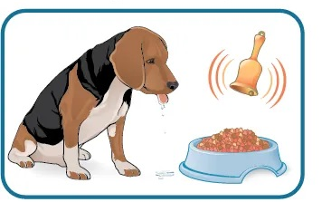
The Pattern Recognition Problem
Learning Meets Perception
Hebbian learning linked co-activation
Reinforcement learning assigned value
Both required recognizable input patterns
But the world is noisy and ambiguous
Single cues mislead or fluctuate
Associative links fail under variation
Notes:
The learning systems we’ve already talked about
—Hebbian and reinforcement learning
—were powerful, but only up to a point.
Hebbian learning strengthened connections between neurons that fired together,
encoding simple associations like “this smell goes with food.”
Reinforcement learning added another layer,
assigning value to outcomes through dopamine signals
that encouraged rewarding behaviors and discouraged costly ones.
But both of these systems depend on one critical thing:
the presence of recognizable patterns in the sensory input.
If the sensory data are too noisy or inconsistent, these learning mechanisms have nothing stable to latch onto.
The animal might strengthen the wrong connections or reinforce the wrong behavior.
So, even though we talk about these mechanisms separately, they were co-evolving.
As learning systems became more flexible, perceptual systems had to become more structured
—able to extract the stable combinations of cues that make learning possible.
Pattern recognition and learning are, in that sense, two sides of the same coin.
But even with Hebbian and reinforcement learning,
early nervous systems faced a major limitation: the world itself is messy.
Sensory cues don’t arrive neatly packaged,
and they don’t always mean the same thing from one moment to the next.
A particular odor might usually signal ripe fruit—but it might also come from decaying vegetation.
When an organism relies on single cues or simple associations, these ambiguities become dangerous.
It might chase false signals and waste energy, or fail to act when it should
—mistaking a real predator for a harmless shadow.
In both cases, the learning system does exactly what it was trained to do; it’s just acting on unreliable input.
That’s the critical point: learning itself isn’t enough.
To behave intelligently in a complex environment,
an organism must recognize when multiple noisy cues together form a reliable pattern.
Pattern recognition evolved precisely because single-cue association
could not cope with the richness and variability of the real world.

Slide 6
The Pattern Recognition Problem
The Core Pattern-Recognition Problem
Distinguish meaningful from irrelevant input
Extract stability from variation
Map patterns to appropriate actions
Notes:
At its core, pattern recognition is about separating what matters from what doesn’t.
Organisms live in environments where the sensory world is full of noise
—random changes, overlapping signals, and incomplete information.
They must find the combinations of cues that predict something meaningful, like food, danger, or safety.
The key is stability amid variation.
The same object or event might appear slightly different each time,
but the brain needs to treat those variations as the same underlying cause.
Recognizing that common structure—what stays constant across change
—is what gives perception its reliability.
And recognition isn’t just about identifying; it’s about acting.
Once an organism can detect stable patterns, it can link those patterns to appropriate behaviors
—approach, avoid, investigate, or ignore.
Pattern recognition is what transforms raw sensation into an actionable understanding of the world.

Slide 7
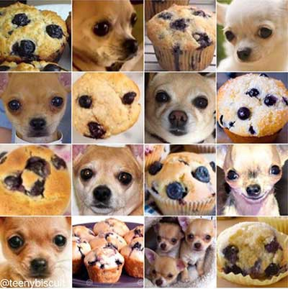
The Pattern Recognition Problem
What Pattern Recognition Is
Detect regularities in sensory input
Map them to internal states or categories
Guide adaptive, context-sensitive behavior
Notes:
We can define pattern recognition as
the ability to detect regularities or structured relationships in sensory input
and map them onto meaningful internal representations or actions.
It’s not just noticing that two signals co-occur
—it’s inferring that together they signify something important about the world.
For example, a certain combination of colors, smells, and textures might correspond to a ripe fruit,
even though none of those cues alone is definitive.
This process is what allows organisms to categorize their experiences
—to form internal groupings that can generalize across different contexts.
Once the system can identify those categories, it can use them flexibly,
linking them to context-sensitive behaviors.
That’s what turns raw sensory data into perception:
a system that interprets the flux of input as structured, meaningful, and actionable.

Slide 8
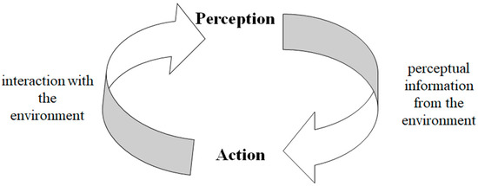
The Pattern Recognition Problem
Perception and Action
Recognition informs movement
Movement changes sensory input
Continuous feedback supports adaptation
Notes:
Perception and action are not separate stages of processing—they’re part of a single continuous loop.
When an organism recognizes a pattern, that recognition guides its movement or behavior.
But every movement also changes what it perceives:
turning the head changes the visual field, swimming alters the chemical gradients,
reaching changes what’s within reach.
This feedback loop makes perception inherently active.
The organism doesn’t passively receive information—it samples and reshapes its own sensory world.
Recognition allows it to interpret what those sensory changes mean in context:
Is this movement bringing me closer to food, or farther from danger?
In this sense, pattern recognition is the glue between sensing and acting.
It provides the interpretive layer that allows each new movement to refine perception,
and each new perception to refine movement,
creating an adaptive cycle of understanding and response.

Slide 9
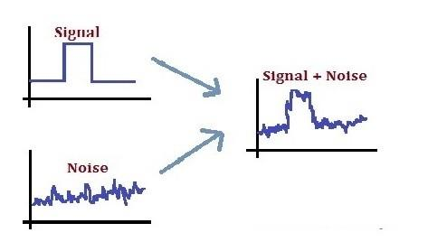
The Pattern Recognition Problem
Signal and Noise
Natural signals are unreliable
Neurons fire stochastically
Decisions must be made under uncertainty
Notes:
No sensory system operates in a perfectly reliable world.
The signals an organism receives—from light, sound, chemical gradients, or touch
—are all shaped by chance fluctuations and environmental interference.
Even within the nervous system, neurons themselves are noisy:
the same stimulus can produce slightly different patterns of activity each time.
This means that every act of perception is really a problem of decision-making under uncertainty.
An animal can never know for sure whether a faint odor or sudden shadow truly indicates something meaningful.
It must constantly make bets—acting as if the world were stable and predictable even when the sensory data are not.
Recognizing patterns in a noisy system requires filtering and averaging across many unreliable signals,
finding the statistical structure that persists despite variability.
That’s as true for the brain as it is for any artificial detection system
—it’s the first major computational hurdle that all pattern recognizers must overcome.

Slide 10
The Pattern Recognition Problem
 |  | Stimulus There for Real
 |  | Yes | Non
Guess That Stimulus Was There | Yes | Hit | False Alarm
 | No | Miss | Correct Rejection
Signal Detection Theory
Hit, miss, false alarm, correct rejection
Balance sensitivity and specificity
Ecology sets the optimal trade-off
Notes:
Scientists describe this basic decision problem using signal detection theory.
It’s a simple but powerful framework for understanding how any perceptual system balances accuracy and risk.
When the system detects a signal, there are four possible outcomes:
a hit if the signal is truly there,
a miss if it was but went undetected,
a false alarm if the system thinks something’s there when it’s not,
and a correct rejection when it correctly ignores noise.
Every sensory system faces a trade-off between
sensitivity—how easily it detects weak signals
—and specificity—how well it avoids false alarms.
Increase sensitivity and you’ll detect more real events, but you’ll also react to more noise;
tighten specificity and you’ll make fewer mistakes, but risk missing important cues.
Evolution tunes this balance to fit an organism’s ecological needs.
For example, a prey animal gains more by being overly cautious
—it’s better to flee a harmless shadow than ignore a predator.
A predator or forager, on the other hand, benefits from restraint,
conserving energy for genuine opportunities.
In both cases, the nervous system’s decision thresholds are adapted to its niche,
optimizing the pattern-recognition process for survival.

Slide 11
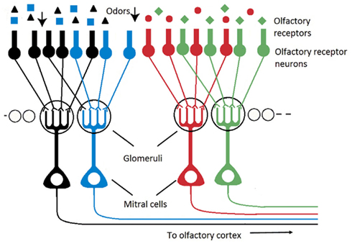
The Pattern Recognition Problem
Biological Noise Reduction
Population coding averages variability
Converging neurons boost reliability
Statistical pooling increases accuracy
Notes:
One of the clever ways brains deal with noise is through population coding
—using large groups of neurons to represent the same kind of information.
Each individual neuron might be unreliable,
firing a little early or late or missing a beat entirely,
but when many neurons with similar tuning fire together,
their collective signal becomes far more stable.
It’s the biological equivalent of averaging across a noisy dataset.
You can see this strategy all over the nervous system.
In the olfactory bulb, thousands of receptor neurons
that respond to the same kind of molecule
converge onto shared targets called glomeruli,
effectively smoothing out random variation in any single receptor.
The same logic appears in the retina,
where ganglion cells combine signals from many photoreceptors,
and in the auditory system, where parallel nerve fibers pool information about sound frequencies.
This redundancy is computationally expensive
—lots of neurons are doing roughly the same job
—but it pays off in reliability.
By averaging across noisy detectors, the brain extracts a cleaner, more trustworthy signal.
In modern terms, it’s a biological form of ensemble averaging,
the same logic behind many noise-resistant algorithms in machine learning.

Slide 12
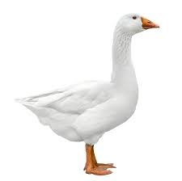
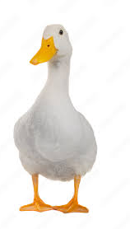
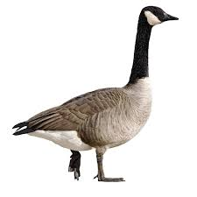
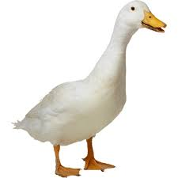
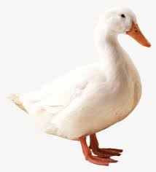
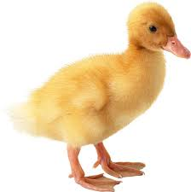
The Pattern Recognition Problem
Discrimination and Generalization
Discrimination separates categories
Generalization groups variants
Both are essential for survival
Notes:
To truly recognize patterns, a nervous system has to master two opposite skills:
discrimination and generalization.
Discrimination is the ability to tell different inputs apart
—to recognize that one smell predicts food while another signals danger.
Generalization is the ability to treat slightly different inputs as the same
—to recognize a familiar food or face even when its sensory details have changed.
Neither one alone is enough.
An organism that only discriminates would treat every small variation as new
—it would have to relearn constantly.
An organism that only generalizes would lump everything together,
mistaking harmful cues for helpful ones.
Intelligence comes from balancing the two:
being sensitive to meaningful differences, but tolerant of harmless variation.
In cognitive and computational terms,
this is one of the deepest challenges in pattern recognition.
Whether we’re talking about a primitive forager or a deep neural network,
every recognition system has to decide where to draw that line
—how far similarity should stretch before two things count as different.

Slide 13
The Pattern Recognition Problem
Receptor 1
Receptor 2
Receptor 3
Receptor 4
Receptor 5
Receptor 6
Receptor 7
Receptor 8
Receptor 9
Receptor 10
 | Move Left Actuator (MLA)
 | Move Right Actuator (MRA)
A Simple Sensory Array
Each receptor detects one feature
Input pattern = activity across sensors
Outputs trigger simple actions
Notes:
Imagine a small organism covered in chemical receptors.
Each receptor responds to a different molecule,
so the whole array of receptors forms a pattern that represents what’s in the surrounding water.
Downstream neurons read this pattern and decide whether to approach, avoid, or ignore.

Slide 14
The Pattern Recognition Problem
Receptor 1
Receptor 2
Receptor 3
Receptor 4
Receptor 5
Receptor 6
Receptor 7
Receptor 8
Receptor 9
Receptor 10
 | Move Left Actuator (MLA)
 | Move Right Actuator (MRA)
From Inputs to Feature Space
Each receptor = one dimension
Pattern = point in high-dimensional space
Categories = regions separated by boundaries
R1
R2
R3
Notes:
This gives us a concrete way to think about pattern recognition:
each moment of sensation is a point in an input space,
and the brain’s job is to map that point to the right behavior.
If we imagine each receptor as one axis,
then every sensory experience becomes a point in a feature space.
Two similar mixtures—say, two kinds of decaying vegetation
—sit close together, while a toxin or food odor sits farther away.
The brain’s recognition task is to draw decision boundaries in this space,
so that one region triggers approach and another triggers avoidance.

Slide 15
The Pattern Recognition Problem
Receptor 1
Receptor 2
Receptor 3
Receptor 4
Receptor 5
Receptor 6
Receptor 7
Receptor 8
Receptor 9
Receptor 10
 | Move Left Actuator (MLA)
 | Move Right Actuator (MRA)
Learning Decision Boundaries
Weights define importance of each feature
Threshold divides outputs
Linear boundary = simple classifier
MLA
R1
MRA
R2
R3
Notes:
A neuron can represent this decision boundary by assigning weights to each input
—stronger weights to important receptors, weaker to irrelevant ones
—and firing if the weighted sum exceeds a threshold.
That’s what a linear classifier does: it draws a straight dividing plane through the feature space.
When inputs fall on one side, the system triggers “approach”; on the other, “avoid.”
This model works remarkably well for many ecological problems,
like distinguishing a mate’s pheromone blend from background chemicals.

Slide 16
The Pattern Recognition Problem
R1
R1
R1
R2
R2
R2
R3
R3
R3
Linearly Separable
XOR
Prototype
When Simple Boundaries Fail
Overlapping cues blur categories
Some rules are nonlinear: XOR (A or B but not both) and Prototypes
Need for multi-layer or hierarchical processing
Notes:
Up to this point, we’ve been talking about cases where simple decision boundaries work
—where the right response can be learned as a single weighted combination of sensory inputs.
But real environments almost never behave that neatly.
Cues don’t add up in straight lines; they interact.
For instance, maybe odor A or odor B alone signals food, but when both are present together, it actually means rot.
That’s a classic nonlinear rule—called an XOR pattern
—because no single linear boundary in sensory space can divide “safe” from “unsafe.”
The organism needs an internal system that can combine cues in more flexible ways,
considering their relationships rather than just their individual strengths.

Slide 17
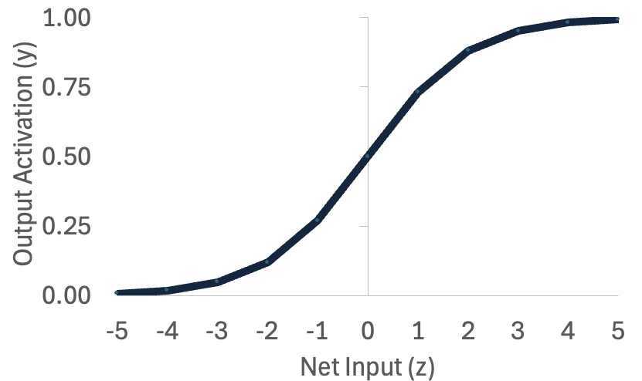
Logical Computation in Neural Circuits
Logical OR Neural Circuit
x₀=1
z
y
Neuron | b | x | x*b
x₀ | -4 | 1 | -4
x₁ | 10 | 1 | 10
x₂ | 10 | 1 | 10
z |  |  | 16
y=sigmoid(z) |  |  | 0.999
Neuron | b | x | x*b
x₀ | -4 | 1 | -4
x₁ | 10 | 0 | 0
x₂ | 10 | 0 | 0
z |  |  | -4
y=sigmoid(z) |  |  | 0.018
b₀
Neuron | b | x | x*b
x₀ | -4 | 1 | -4
x₁ | 10 | 1 | 10
x₂ | 10 | 0 | 0
z |  |  | 6
y=sigmoid(z) |  |  | 0.998
b₁
x₁
b0 | b1 | b2
-4 | 10 | 10
b₂
x₂
x0 | x1 | x2 | y
1 | 1 | 1 | 1
1 | 1 | 0 | 1
1 | 0 | 1 | 1
1 | 0 | 0 | 0
x0 | x1 | x2 | y | o
1 | 1 | 1 | 1 | .018
1 | 1 | 0 | 1 | .998
1 | 0 | 1 | 1 | .998
1 | 0 | 0 | 0 | .999
Notes:
We can show that an OR circuit is very easy to create.
First, let’s show our truth table. But we’re going to add a column for our bias unit.
Remember this y value is not the OR of x0 and x1 and x2, just the OR of x1 and x2.
But it’s still a function, in the sense that there is one correct output value of y for every combination of inputs.
We can see that y is 1 when either x1 or x2 is 1, and 0 otherwise.
Now, let’s show a table of hypothetical weights: [-4, 10, 10].
Our bias (b0) is -4, which means our output neuron will be inhibited from firing in the absence of other input.
Our weights from both x1 and x2 are 10, meaning the neuron will be excited by activation from either of input neurons.
And note that this activation strength of 10 is higher than the inhibitory strength of 4.
This means that either input will overwhelm the neuron’s inhibitory bias and make it fire. We can show that with specific example tables.
The first shows the calculation of the firing rate of the output neuron when one but not the other input is firing at its maximum rate.
The net input is 6 (-4+10+0).
When put through the sigmoid activation function the result is an output activation of 0.998.
The second shows the calculation of the firing rate of the output neuron when both inputs are firing at their maximum rate.
The net input is 16 (-4+10+10).
When put through the sigmoid activation function the result is an output activation of 0.999.
Note that because the sigmoid function maxes out at 1, and that point was already nearly reached when the net input was 6.
Going from a net input of 6 to 16 makes very little difference in the output firing rate because it has already maxed out.
We can compare to the calculation of the firing rate of the output neuron when neither input is firing.
The net input is -4(-4+0+0).
When put through the sigmoid activation function the result is an output activation of 0.018.
So for an OR circuit, we want to inhibit the output neuron, but only a little bit, such that that inhibition can be overcome by a single input.

Slide 18
Logical Computation in Neural Circuits
Function | b0 | b1 | b2
AND | -15 | 10 | 10
OR | -4 | 10 | 10
Takeaway: AND vs. OR
For both functions, both inputs need to have the same positive weights
But the two functions need to have different bias values
Bias = neuron’s threshold or baseline activity
0,1
1,1
1,1
0,1
AND
OR
x1
x1
0,0
x2
0,0
1,0
x2
1,0
Notes:
Here’s the big idea to take away.
In both AND and OR, we used the same setup: two positive weights. The difference wasn’t in the wiring — it was in the bias.
Bias is like the neuron’s built-in threshold, or its baseline firing rate.
If the bias is more negative, it takes stronger input to activate the neuron.
That gave us AND. If the bias is less negative, weaker input is enough, which gave us OR.
We can also think about this in terms of the decision boundaries we introduced earlier.
Here, we plot our four inputs as points on a graph, and color code the responses green if the output neuron should be 1, and red if zero.
As you can see, the colors are different for AND and OR reflecting the differences in those logical structures.
To get a neural network to work correctly for these two logical functions, all we need to do is draw the decision boundary in a slightly different place.
So the distinction between AND and OR isn’t about different circuit structures.
It’s about how ‘picky’ the neuron is — how much input is required to push it over the threshold.
That’s a powerful idea: small parameter changes in a simple model can lead to very different computations.

Slide 19
Logical Computation in Neural Circuits
x₀=1
b₀
z
y
Logical XOR
XOR = output 1 if inputs are different
Not linearly separable (can’t do with 1 neuron)
Solution: combine AND, OR, NOT
b₁
x₁
x1 | x2 | y
1 | 1 | 0
1 | 0 | 1
0 | 1 | 1
0 | 0 | 0
b₂
x₂
1,1
1,1
0,1
0,1
XOR
OR
x1
x1
0,0
0,0
x2
x2
1,0
Notes:
Now that we’ve seen single neurons approximate AND and OR, let’s look at a harder case: XOR.
XOR outputs 1 when the inputs are different — (1,0) or (0,1) — but 0 when they’re the same.
This is actually a very hard problem, and impossible to create in a neural circuit of the type we have been using so far.
Conceptually it is somewhat easy to understand. The (0,0) situation should lead to a 0, so we want a negative bias just like AND and OR.
The bias needs to be overcome by either or our inputs, so the negative bias should be lower than the positive weight of both of our x inputs.
But when both inputs are on, we want the output neuron to be inhibited again.
There’s no way to get our output neuron to correctly respond to the either/or case ((0,1) and (1,0)) in a way that is opposite of our AND (1,1,) case.
We can also understand it in terms of decision boundaries.
There is no way to draw a single line to divide the green dots and red dots on separate sides.
Because of this, XOR is described as a problem that is not linearly separable, in contrast to AND and OR, which are linearly separable.

Slide 20
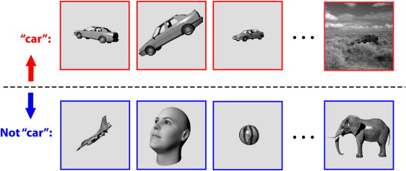
The Pattern Recognition Problem
Invariance Problem
Same object, different inputs
Sensory patterns shift with context
Recognition must extract stable features
Notes:
Even when the relationships among cues are simple, another challenge appears—the invariance problem.
The same real-world object can produce very different sensory patterns depending on context.
A fruit looks different in shadow than in sunlight;
a predator’s shape changes with distance or angle;
a sound varies with pitch, volume, and echo. Even when the relationships among cues are simple, another challenge appears—the invariance problem.
The same real-world object can produce very different sensory patterns depending on context.
A fruit looks different in shadow than in sunlight; a predator’s shape changes with distance or angle; a sound varies with pitch, volume, and echo.
If the nervous system treated every version of those inputs as distinct, it would have to relearn the same thing endlessly.
To function efficiently, a brain must recognize that all these sensory variations belong to the same underlying cause.
That means extracting invariant features—the aspects of an input that stay consistent even as the raw data change.
This is no small feat.
In sensory space, those different views or conditions can be far apart, sharing few active receptors or neurons in common.
Yet we can still tell it’s the same object or event.
That capacity for constancy is one of the hallmarks of higher-level perception—and one of the hardest problems to reproduce in machines.
Invariance forces a system to move beyond direct sensory input and toward representation:
building internal models that capture what remains the same across change.
It’s the next great functional hurdle of pattern recognition—and one that links perception to abstraction and memory.

Slide 21
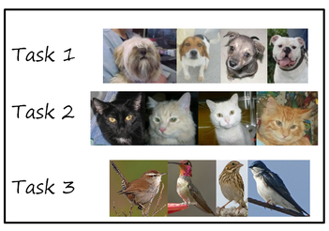
The Pattern Recognition Problem
Continual Learning and Interference
World and experience constantly change
Learning risks overwriting old knowledge
Brains balance stability-plasticity dilemma
Notes:
So far, we’ve talked about pattern recognition as if it were a purely spatial problem
—how to carve up sensory space so that different patterns fall into meaningful categories.
But in real life, learning unfolds over time, and the world doesn’t stay still.
New patterns appear, old ones fade, and experience itself is uneven
—some things are encountered constantly while others are rare.
This introduces a new challenge called continual learning.
Each new experience reshapes the neural weights or boundaries that define what a system recognizes.
If those new patterns overlap with older ones, learning can interfere
—pulling the same neurons or connections in conflicting directions.
In machine learning, this leads to catastrophic forgetting,
when a network trained on new data suddenly forgets what it knew before.
Biological brains face the same risk but handle it far better.
They solve the stability–plasticity dilemma
—the trade-off between keeping knowledge stable and remaining adaptable.
Too much plasticity, and you lose what you’ve learned;
too much stability, and you can’t adapt to change.
Real nervous systems find a middle ground: as we will talk about later, they use mechanisms like
replay during rest,
sparse coding to separate memories,
and neuromodulators to gate when learning can occur.
Continual learning shows that pattern recognition isn’t just about identifying the structure of the world
—it’s also about preserving those structures over time,
even as the brain keeps updating its understanding of what the world is like.

Slide 22
The Pattern Recognition Problem
Summary
Pattern recognition co-evolved with learning
Challenges: noise, overlap, nonlinearity, and change
What’s Next:
How biological and artificial systems solve these problems
Notes:
Today, we’ve explored what pattern recognition is and why it’s such a hard problem to solve.
We saw how simple learning systems
—Hebbian and reinforcement learning
—depend on stable sensory structure,
and how recognizing patterns in a noisy, changing world required new kinds of neural organization.
Pattern recognition evolved to
handle noise,
distinguish overlapping inputs,
generalize across variation,
and adapt without erasing old knowledge.
In short, it’s the function that makes perception intelligent.
It’s what allows organisms to find order in chaos, to connect sensory signals to meaningful categories and actions.
And it’s what makes modern AI systems
—like image recognition networks or speech models
—such striking, if still incomplete, analogs of biological brains.
In the next lecture, we’ll shift from function to algorithm:
how both evolution and computer science have tackled these challenges
through hierarchical, nonlinear, and adaptive architectures.
We’ll see how adding layers, feedback, and abstraction lets systems
—biological and artificial—begin to solve the very problems we outlined today.

